Slide 2
Objectives
Understand that data is broken down into packets to be transmitted
Describe the structure of a packet including
Packet header (destination address, packet number, originator’s address)
Payload
Trailer
Describe the process of packet switching including:
Packets, routing, routers, packet order and reordering

Slide 3

Starter
A law firm needs to send a client 1000 pages of important documents through the postal network
Due to weight limits a maximum of 200 pages may be sent at a time
How is it possible to send the large document?

Slide 4


Starter
How is it possible to send the large document?
The document is broken up into different sections
Each section is sent in its own packet
Each packet will need the client’s address and the law firm’s address (in case it doesn’t arrive or there is a problem)
Each packet needs to say which document number from the sequence it is

Slide 5


Data packets
We often need to send large amounts of data through networks
This is carried out by breaking down the data into lots of smaller packets
The system works in a similar manner to a postal network that allows many users to send different packages and letters
What information do you think each data packet needs to contain?

Slide 6
Data packets
The data is split down into smaller fragments that make up the payload of each packet
The header contains the destination address, originating address (source address) and the packet number so that the correct order is restored once it arrives
The payload is the contents that need to be sent
The trailer has data that indicates the end of the packet and a checksum for the destination to check it transmitted correctly
Header |  |  | Payload | Trailer
Destination address | Originating address | Packet number | Payload | Trailer
One data packet

Slide 7
Worksheet 1
Complete Task 1 on Worksheet 1

Slide 8

Packet switching
The process for sending data through a network is known as packet switching
Routers control the specific route that each packet takes
What happens at the end of the process?
1. Break down data into packets
2. Send the packets through the network
3. Routers control the route taken
?

Slide 9
Packet switching
As each packet may take a different route through the network, they may arrive out of order
The destination computer or server will need to reorder the packets into the correct order
The packet number is used to do this
1. Break down data into packets
2. Send the packets through the network
3. Routers control the route taken
4. Reorder packets into correct order

Slide 10
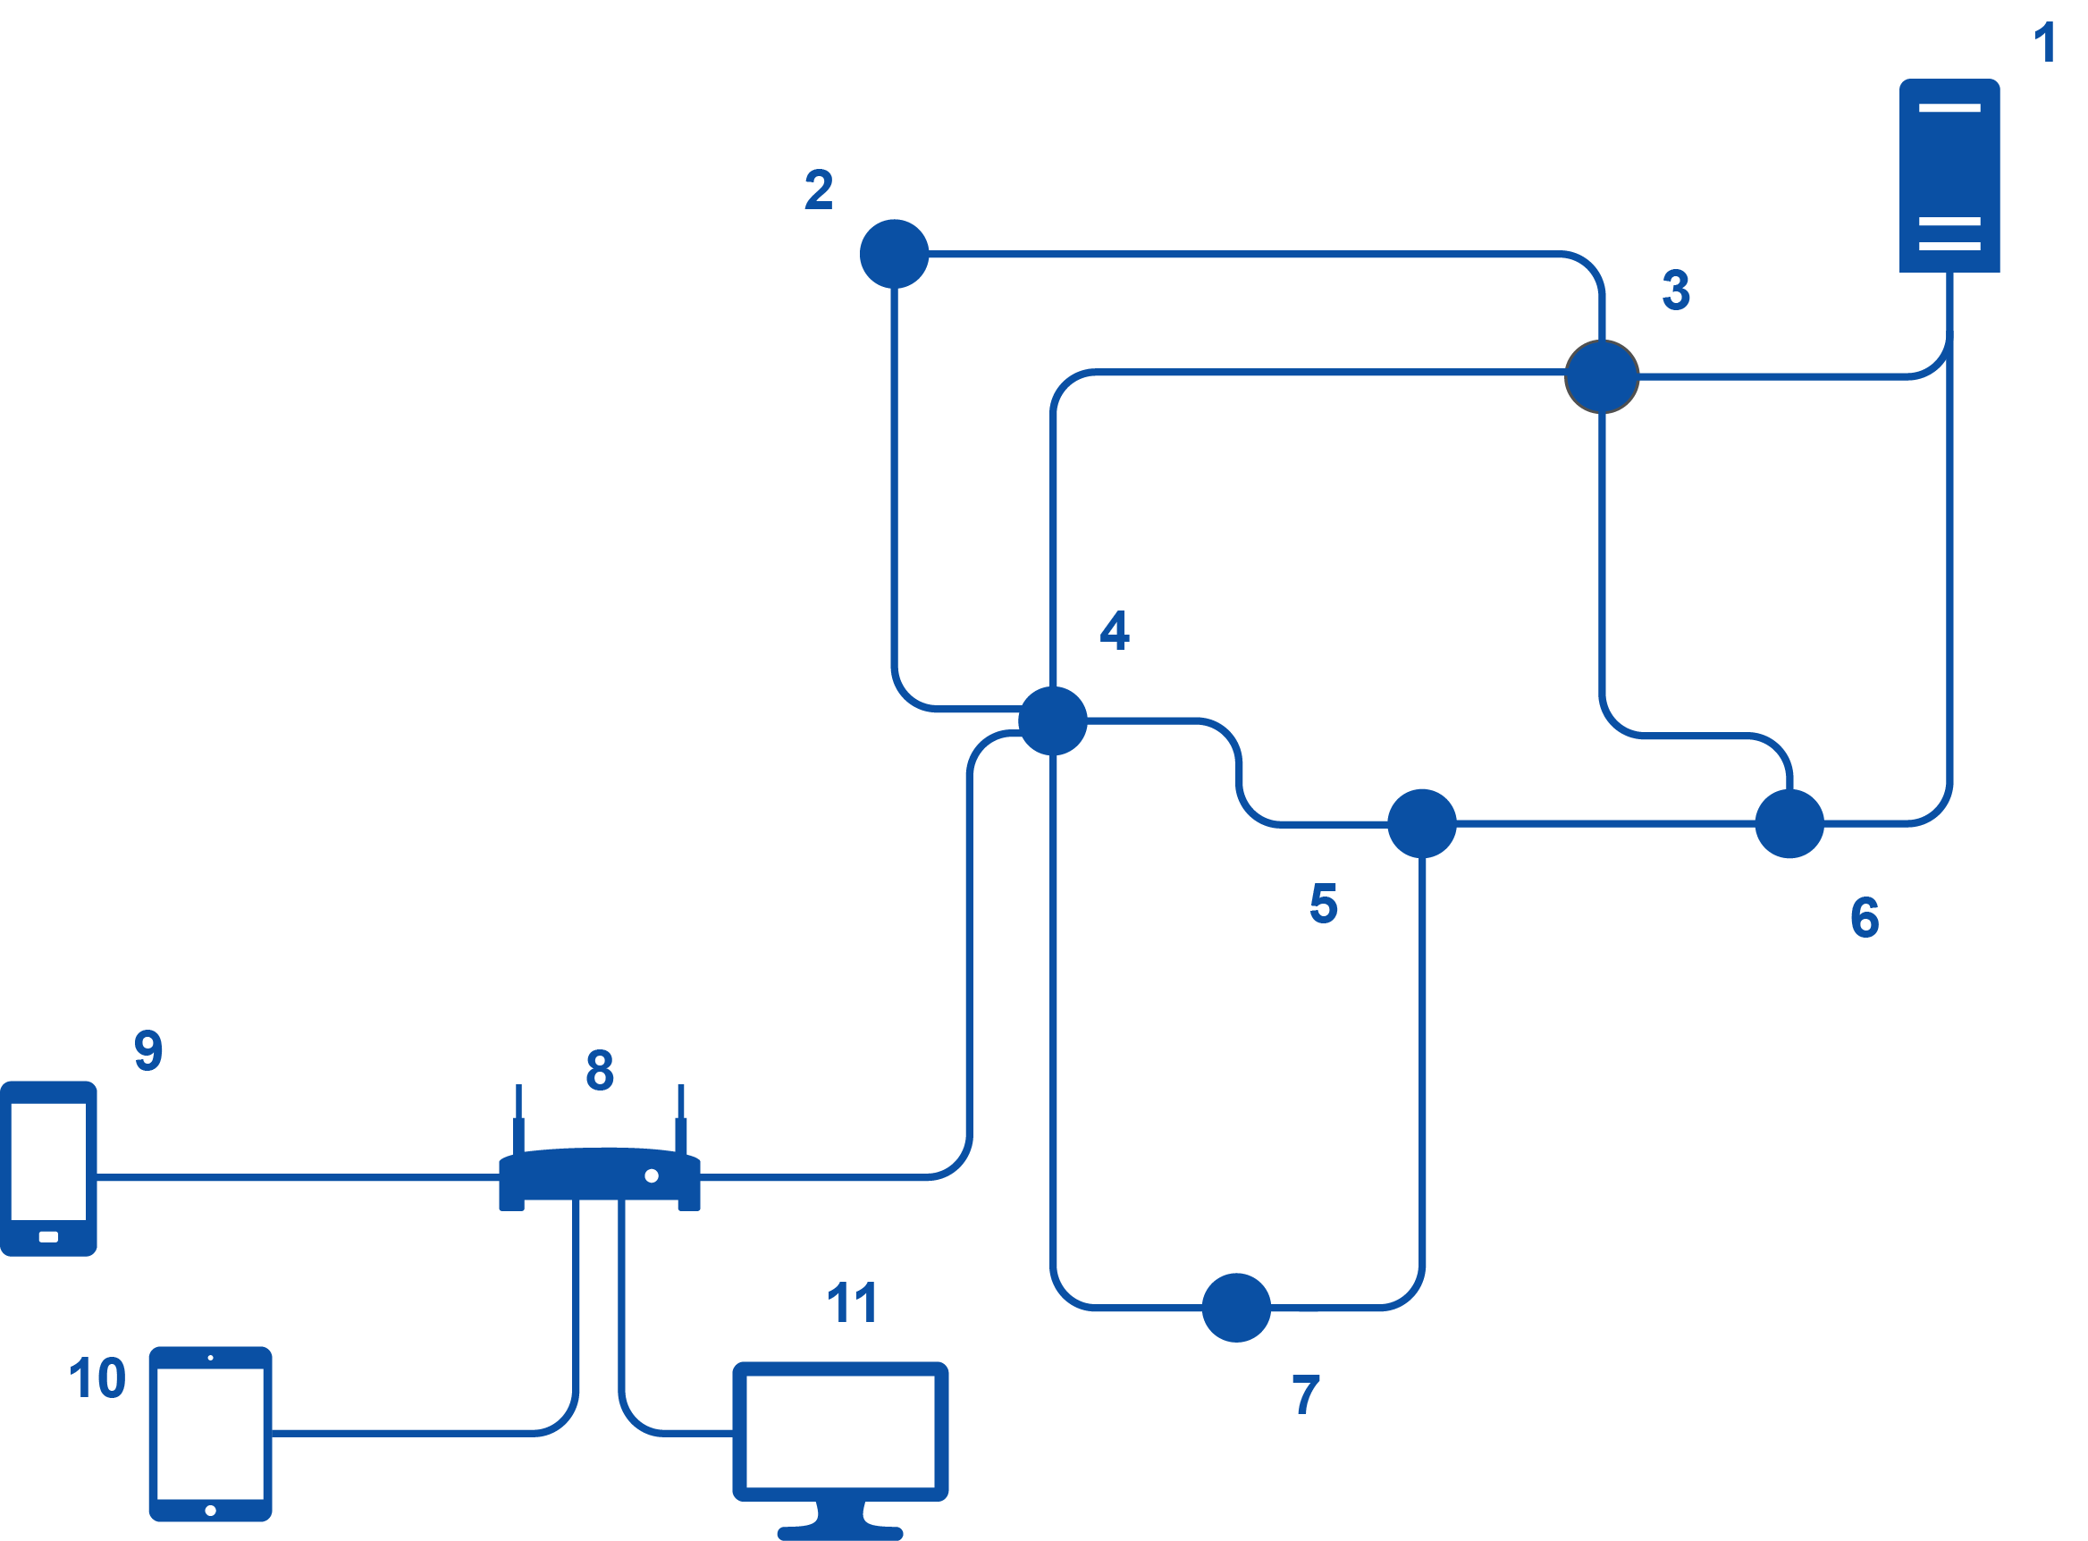
Packet switched network
The diagram shows a number of components that are part of a network
What is each component?

Slide 11
Packet switched network
Number | Component
1 | Server
2-7 | Routers
8 | Wi-Fi access point and router
9, 10, 11 | Smartphone, tablet, desktop

Slide 12
Worksheet 1
Complete Task 2 on Worksheet 1

Slide 13

Plenary
What are the roles of the following concepts when sending information through the Internet?
Data packets
Packet switching
Routers
State the different components of each packet

Slide 14
Plenary
To send data, such as a file through the Internet, it is first split into fragments known as packets. Packet switching is then undertaken by each router on the network. Each packet is directed to another closer router. Each packet may take a different route through the network. Packets may arrive out of order. Once the last packet has arrived, the packets are reordered.
State the different components of each packet
Packet header: destination address, packet number, originator’s address (source address)
Payload – the data being sent
Trailer

